Slide 1

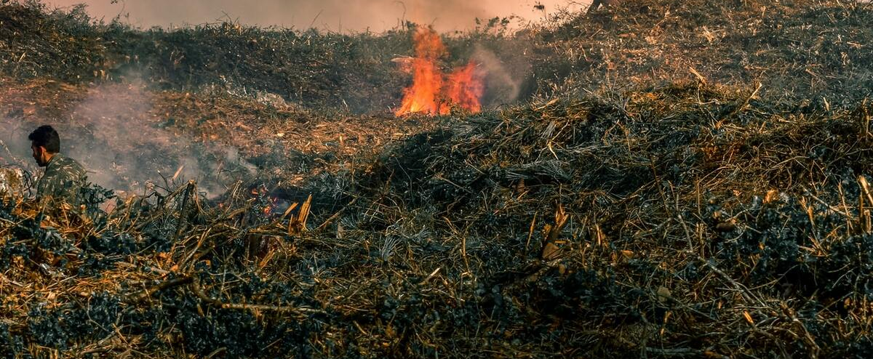
Wild Fire Prediction
Group Name:Data Transformers

Slide 2
Introduction:
Wildfires are one of the biggest catastrophes faced by our society today causing irrevocable damages.
These forest fires can be man-made or caused by mother nature by different weather conditions, torrential winds.
These fires cause damages not only to the environment they also destroy vast homes and property.
With the help of big data analysis and machine learning algorithms we intend to build a tool which serves an aid to the society and thus prevent the occurrences of this disaster.

Slide 3

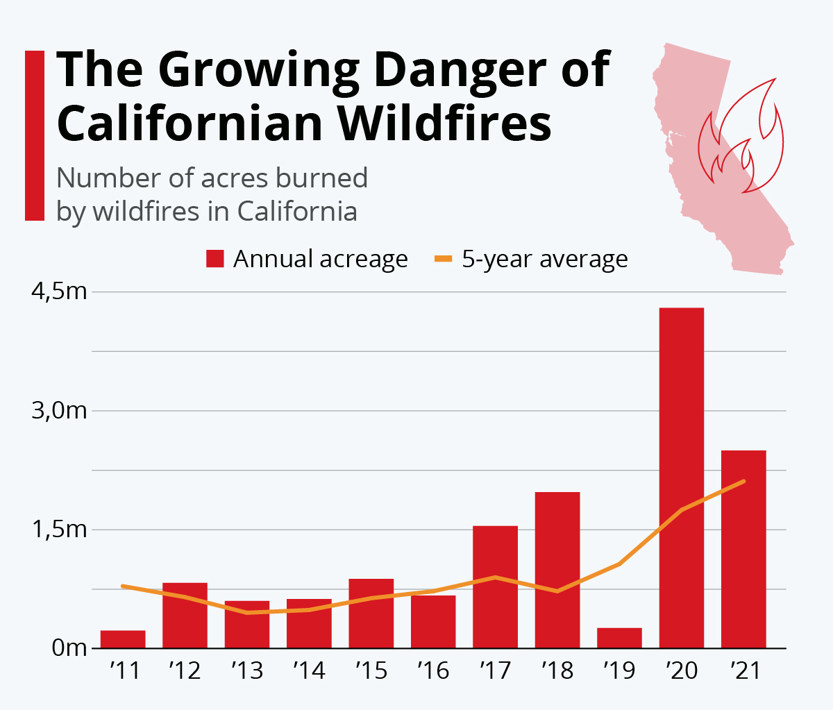



Overall in the year 2022 total of 6739 fires occurred in North America
There was a loss of 365895 acres land because of this wild fire
This makes 2022 the most active wildfire season in more than 10 years.
This has inspired us to develop a model that can help us to predict and prevent these wild fires.

Slide 4
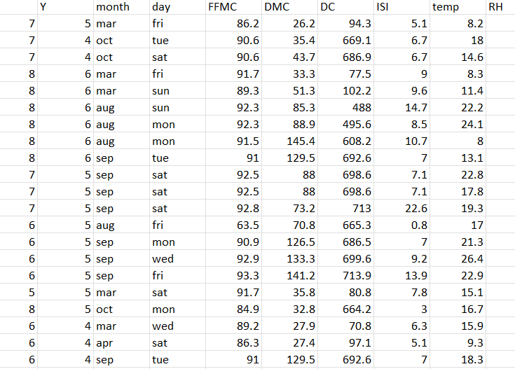
Montesinho Park Wild Fire Dataset:
Independent Variables:
X
Y
Month
Day
FFMC - Fine Fuel Moisture Code
DMC - Duff Moisture Code
DC - Drought Code
ISI - Initial Spread Index
Temperature
RH – Relative Humidity
Wind
Rain
Dependent Variable:
Area

Slide 5
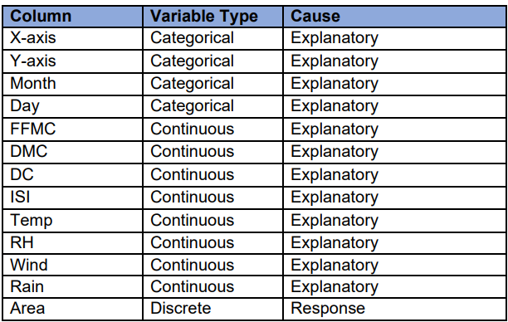
Solution methodology and evaluation metrics
Algorithms used are Linear regression , Decision tree , Logistic Regression.

Slide 6
Linear regression algorithm:
set.seed(1234)
dt<-sample (2, nrow(data), replace = TRUE, prob=c (0.8,0.2))
train<-data[dt==1,]
validate<-data[dt==2,]
model = lm(area~.-month-day,data = train)
summary(model)
As we can see linear regression did not work well with our model, we achieved an RMSE of 1.62 and Adjusted R squared of 0.07.
predict(model,validate)
Outcomes:
Mean Absolute Error :1.23912
Root Mean Squared Error :1.619865
Relative Absolute Error :1.023707
Relative Squared Error :1.199358
Coefficient of Determination :-0.199358

Slide 7
Decision Tree:
set.seed(1234)
dt1<-sample (2, nrow(data), replace = TRUE, prob=c (0.8,0.2))
train1<-data[dt1==1,]
validate1<-data[dt1==2,]
model <- train(
area ~ .,
data = train1,
method = 'rpart2’
)
model
Outcome:
CART
419 samples
12 predictor
Pre-processing: centered (27), scaled (27)
Resampling: Bootstrapped (25 reps)
Summary of sample sizes: 419, 419, 419, 419, 419, 419, ...
Resampling results across tuning parameters:
maxdepth RMSE Rsquared MAE
1 0.878234 0.528826124 1.181407
2 0.938456 0.539814424 1.179835
3 0.845693 0.519526733 1.187688

Slide 8
Logistic Regression:
set.seed(1234)
dt<-sample (2, nrow(data), replace = TRUE, prob=c (0.8,0.2))
train2<-data[dt==1,]
validate2<-data[dt==2,]
model3 = glm(area~.-month-day,data = train2)
summary(model3)
Outcomes:
(Dispersion parameter for gaussian family taken to be 4922.899)
Null deviance: 2064149 on 418 degrees of freedom
Residual deviance: 2008543 on 408 degrees of freedom
AIC: 4764.1
Number of Fisher Scoring iterations: 2

Slide 9
Model Summary:
Algorithm | RMSE | Adjusted R Square
Linear Regression | 1.62 | 0.07
Decision Tree | 0.85 | 0.42
Algorithm | Null Deviance | Residual Deviance
Logistic Regression | 2064149 | 2008543
With Decision Tree Regression, we achieved an RMSE of 0.85 which is much better than the previous models.
So, we can use this model with confidence to predict the area a forest fire will cover.

Slide 10
Conclusion:
In tackling this problem, millions of dollars can be saved in the fight against forest fires as efforts can be concentrated on reducing the spread of fire that may engulf a significant area. Having explored the data and modeling, here are our findings and recommendations for predicting the forest fire area:-
• The data that we had wasn't balanced and also heavily right skewed for the response variable, area. So a better data set could have produced significantly better results than the ones we got.
• The data was restricted to a specific geological region (Portugal in our case). A more diverse dataset could have added more value to our findings by representing a wider range of geological conditions.
• The RMSE and adjusted R squared value are good enough to recommend using the model because it correctly predicted the larger forest fires, which was the problem we set out to solve. Predicting smaller forest fires as larger forest fires remains a challenge that can be overcome by fine-tuning Decision Tree Regression parameters.
References:
https://www.kaggle.com/code/rhernandez101779/montesinho-forest-fire-data-analysis
https://en.wikipedia.org/wiki/2022_California_wildfires

Slide 11
Roles and Responsibilities:
Name | U-number | Contribution
Lakshmi Sravya Dama | U49350624 | Topic selection and dataset
Sudeshna Mullaguru | U11723314 | Model selection and analysis
Pavan Gopi Boppana | U99855563 | Algorithms of models
Nikhil Reddy Kotwal | U27895047 | Interpretation of Data
Banula Sandeep | U77307290 | Result Analysis

Slide 12
THANK YOU

